Slide 1
Rating prediction project
Submitted by:
Rohit Kattewar

Slide 2
Introduction
In this project I have scrapped 20400 different reviews and rating of the different set of products from a website where people write different reviews for technical products is called “Amazon.in”. I built a model which can predict the rating by seeing the review.

Slide 3
Data collection
I have scrapped total 20400 different reviews and ratings for the products like laptops, smartphones, Headphones, smart watches, Printers, Monitors, Home theater, Router from the globally known website named “Amazon.in”.

Slide 4
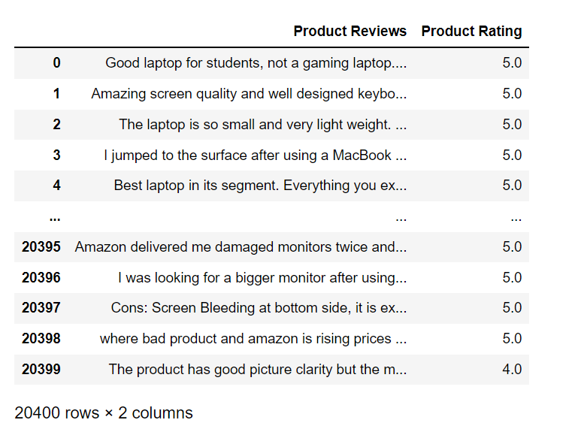
Dataset

Slide 5
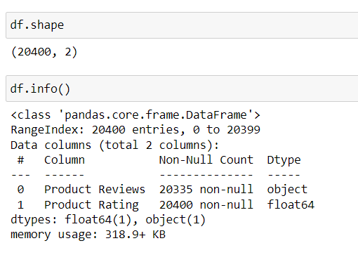
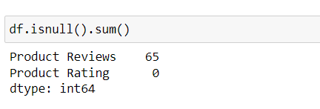
Descritpion of the dataset

Slide 6
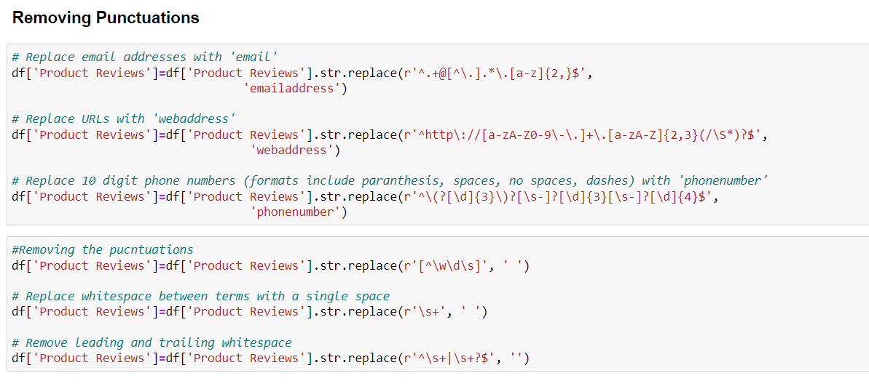
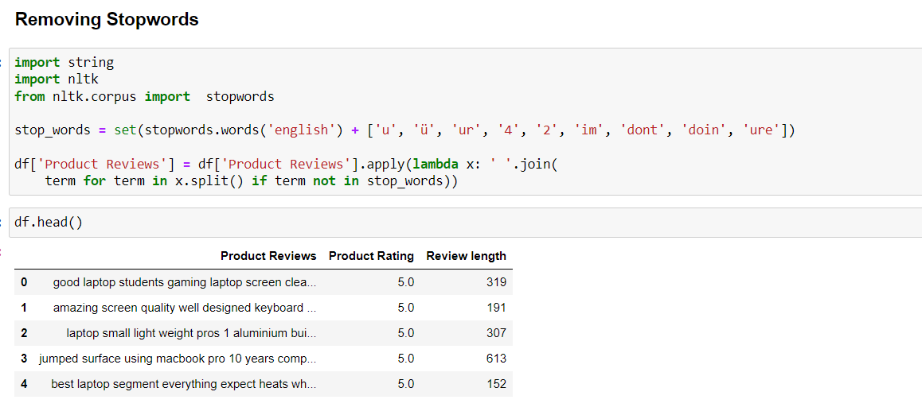
Data pre-processing

Slide 7
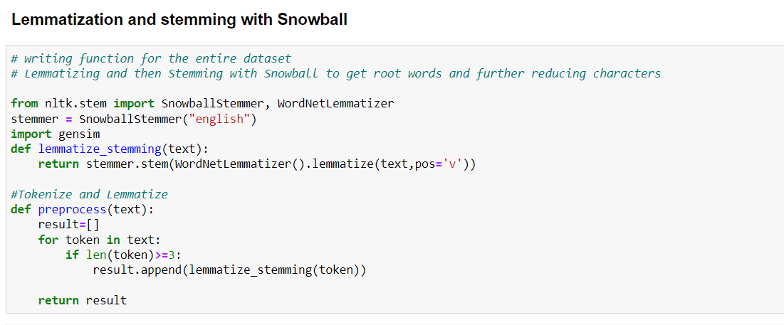
Data pre-processing

Slide 8
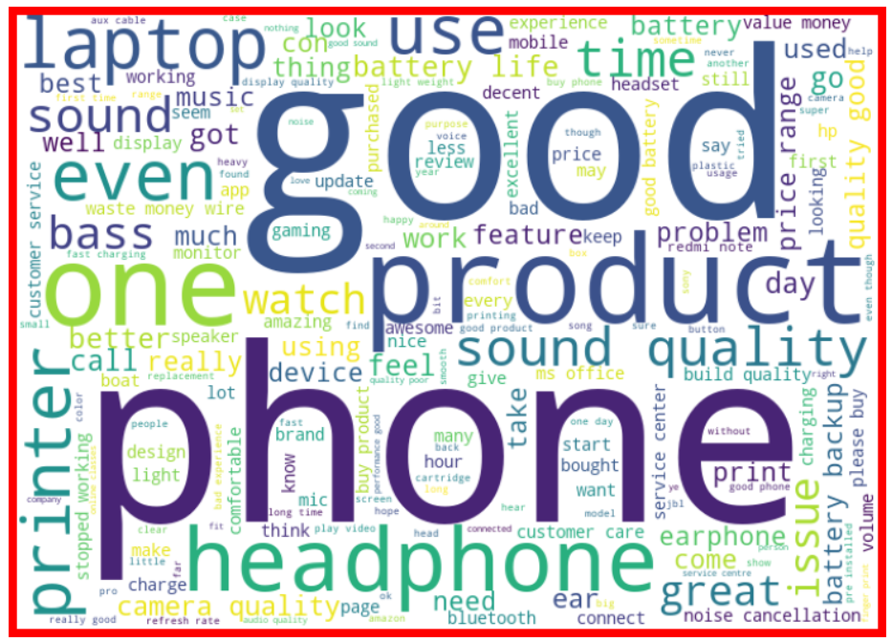
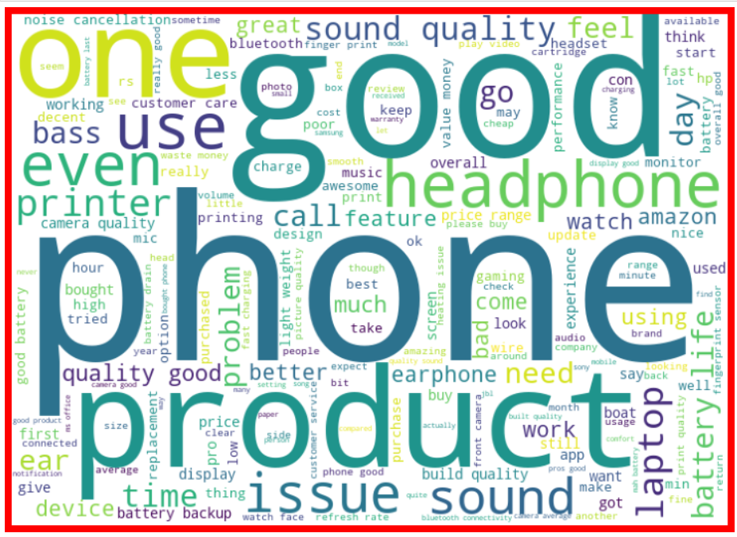
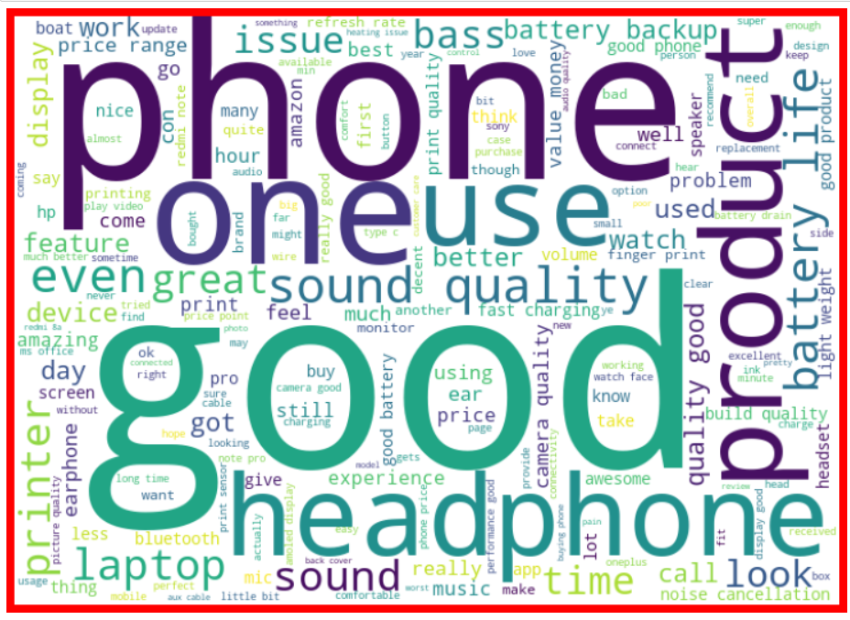
Analysis using word cloud

Slide 9
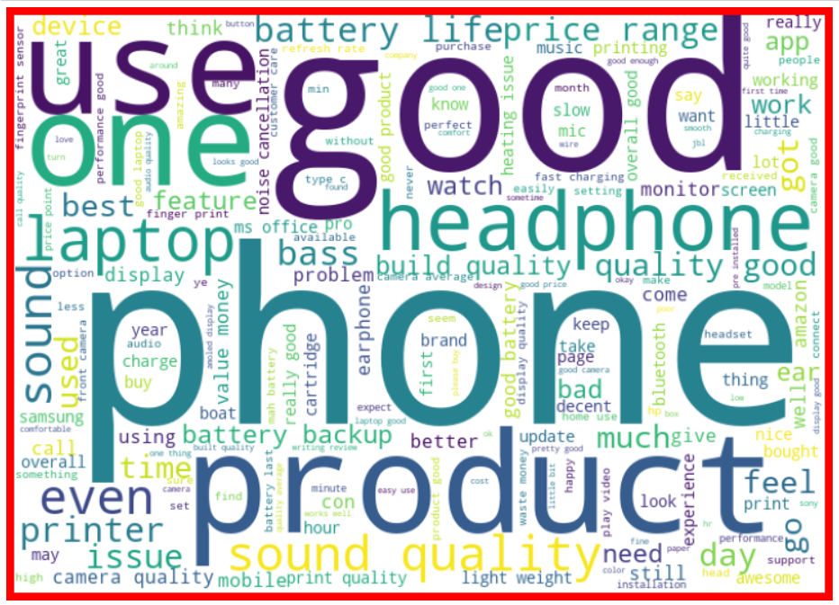

Analysis using word cloud

Slide 10
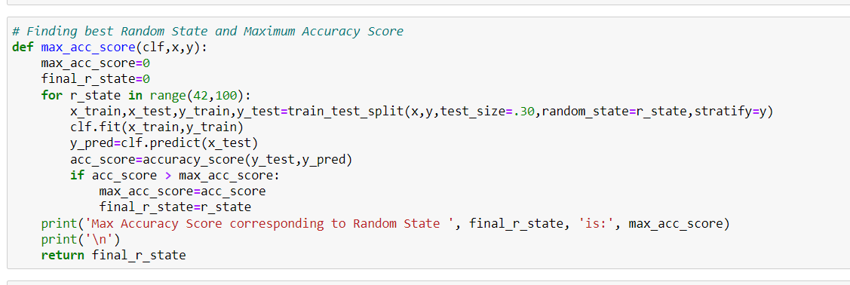
Model building

Slide 11
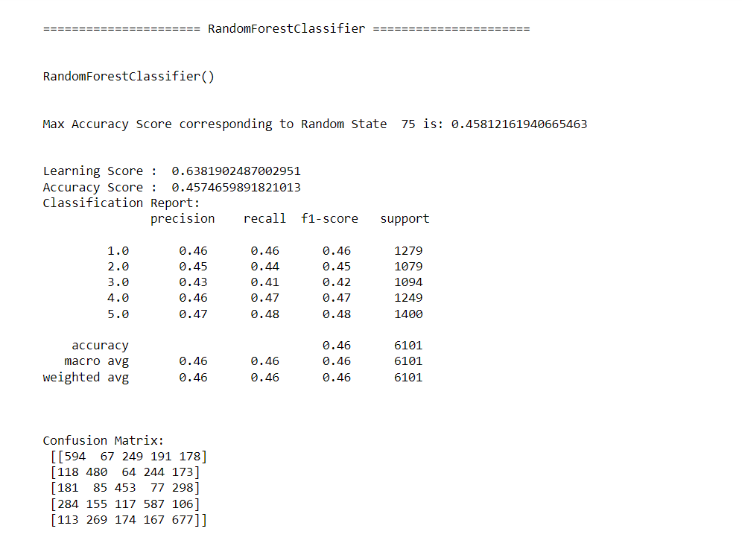
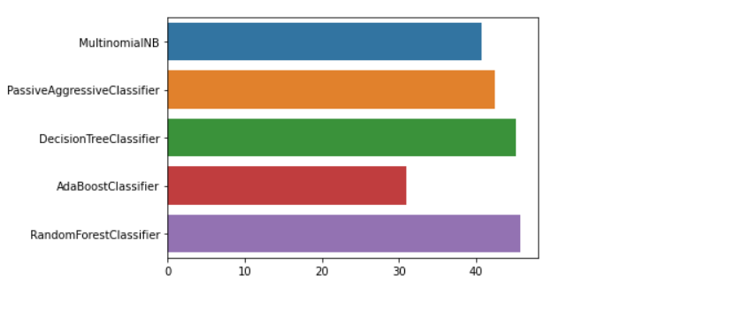
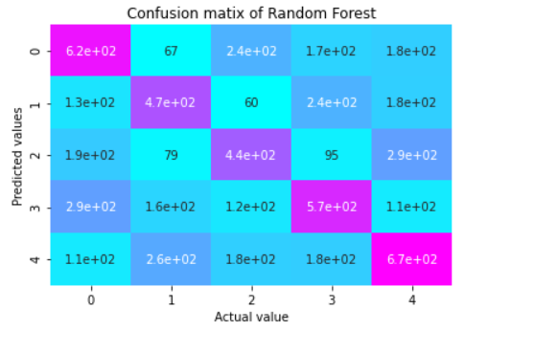

Slide 12
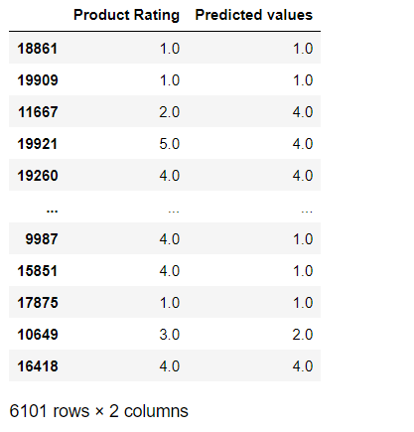
Predicted values

Slide 13
conclusion
1. The various data pre-processing and feature engineering steps in the project lent cognizance to various efficient methods for processing textual data. The NLTK suite is very useful in pre-processing text-based data and building classification models.
2. Data cleaning was a very important step in removing null values from the dataset.
3. By training the models on more diverse data sets, longer comments, and a more balanced dataset, more accurate and efficient classification models can be built.

